Slide 1
OPTICAL CHARACTER RECOGNITION
DOMAIN: FULL-STACK & M.L.
GUIDE NAME: Assistant Prof. Akanksha Submitted By:
Anoop Kumar (1900290120017)
Himanchal kr. Gautam(1900290120046)
DEPARTMENT: Computer Science
BATCH:2019-2023

Slide 2

INTRODUCTION

Slide 3
PROBLEM STATEMENT

Slide 4
RESEARCH OBJECTIVES

Slide 5
METHODOLOGY

Slide 6
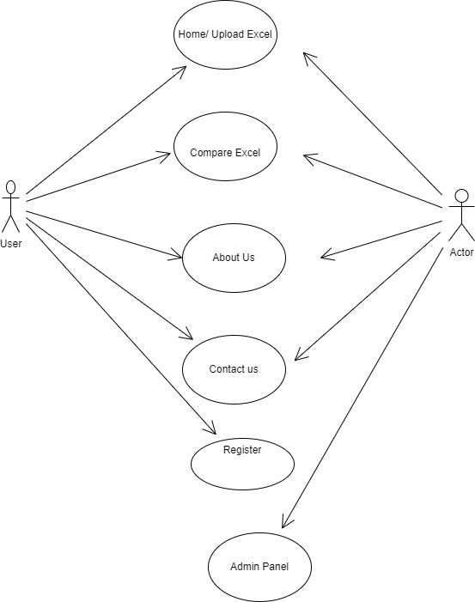
USE CASE DIAGRAM

Slide 7
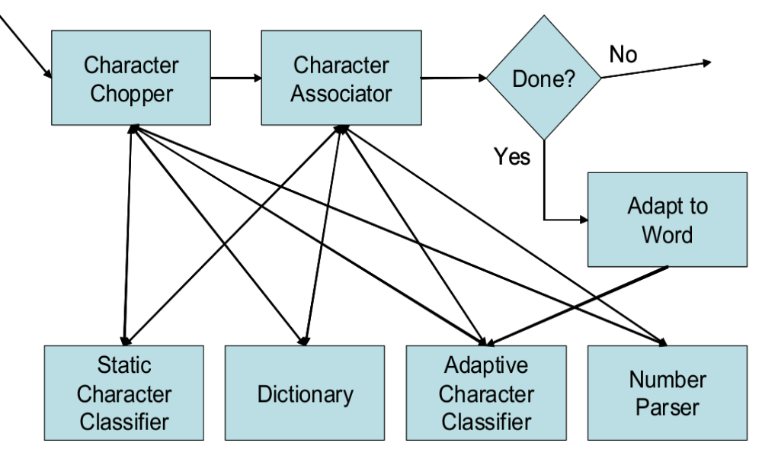
Block diagram of Word Recogniser.

Slide 8
Tech Stack used
FRONT END | HTML, CSS, JavaScript
FRAMEWORK/LIBRARY | Font Awesome, Google Font, Bootstrap
BACKEND | Python, Django, Machine Learning some other python library
TEXT EDITOR | Visual Studio Code
DATABASE | SQLite3

Slide 9
OUTCOME OF THE PROJECT
Patent
Research paper
Future Scope

Slide 10
REFERENCES(optional)

Slide 11
THANK YOU

